Slide 1
Local Property Listing
A WEB APPLICATION PROJECT

Slide 2
AGENDA
Introduction​
Problem statement
Goals and objectives
Proposed work
​Implementation details
Conclusion

Slide 3

Introduction
The real estate process can be time-consuming, frustrating and full of back-and-forth discussions between a seller. But, if you’re able to optimize the sales process, buying process, not only will you save time, you can close deals quicker. Also, handling the real estate sales process properly can ensure a seller, buyer will turn to you next time they want to sell or buy another property.

Slide 4
Problem statement
In this project, we have created a website through which, users can list their properties to be sold or rented. There will also be a home page, where potential buyers will be able to browse through different listed properties, and find the best place suited for them.

Slide 5
Goals and objectives
To Provide a platform to be able to buy, sell, rent properties efficiently.
Provide an online market presence, to attract more users.
Provide filters, based on location, budget, duration of stay, etc.
Provide an Image and Video Gallery to allow experience the property better.

Slide 6
Proposed work
Project Planning and Requirements Gathering
Website Design and Development
Database Management
Deployment and Maintenance

Slide 7
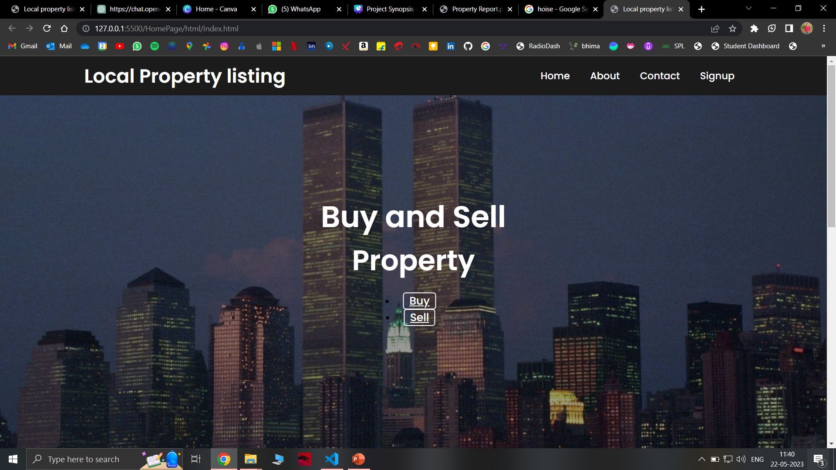
​Implementation details
This is the HomePage

Slide 8
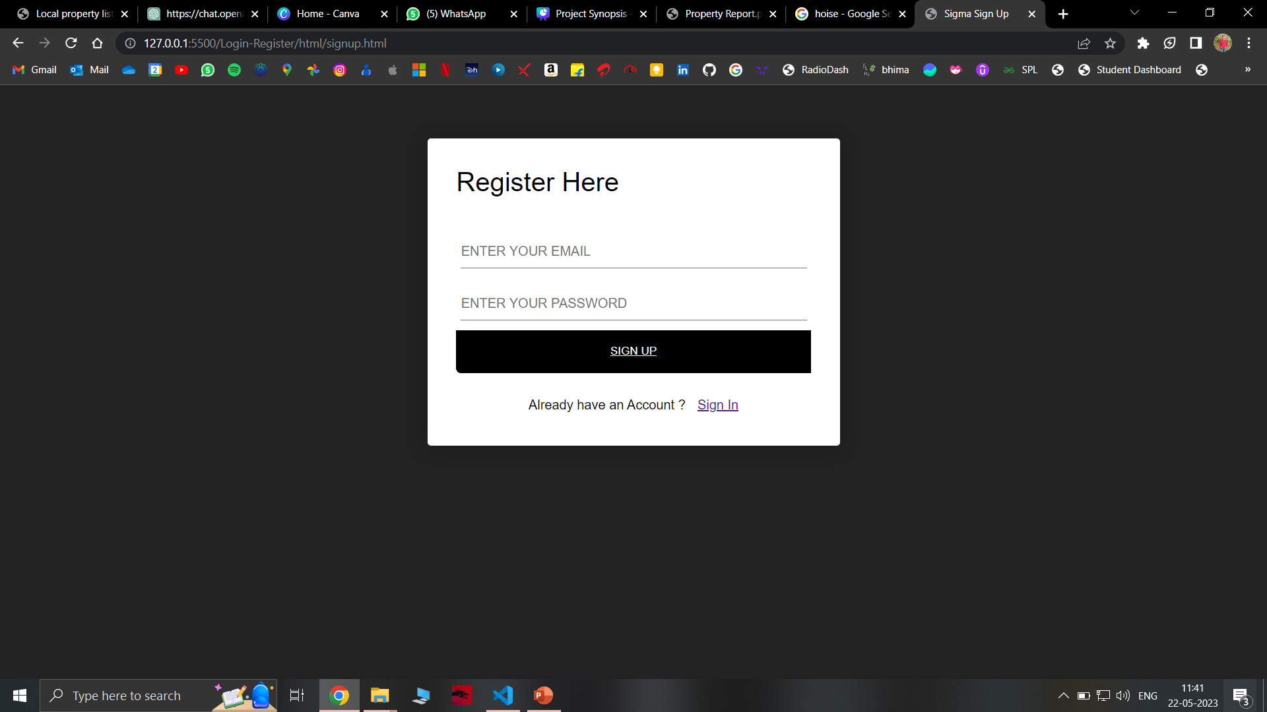
​Implementation details
This is Registration Page

Slide 9
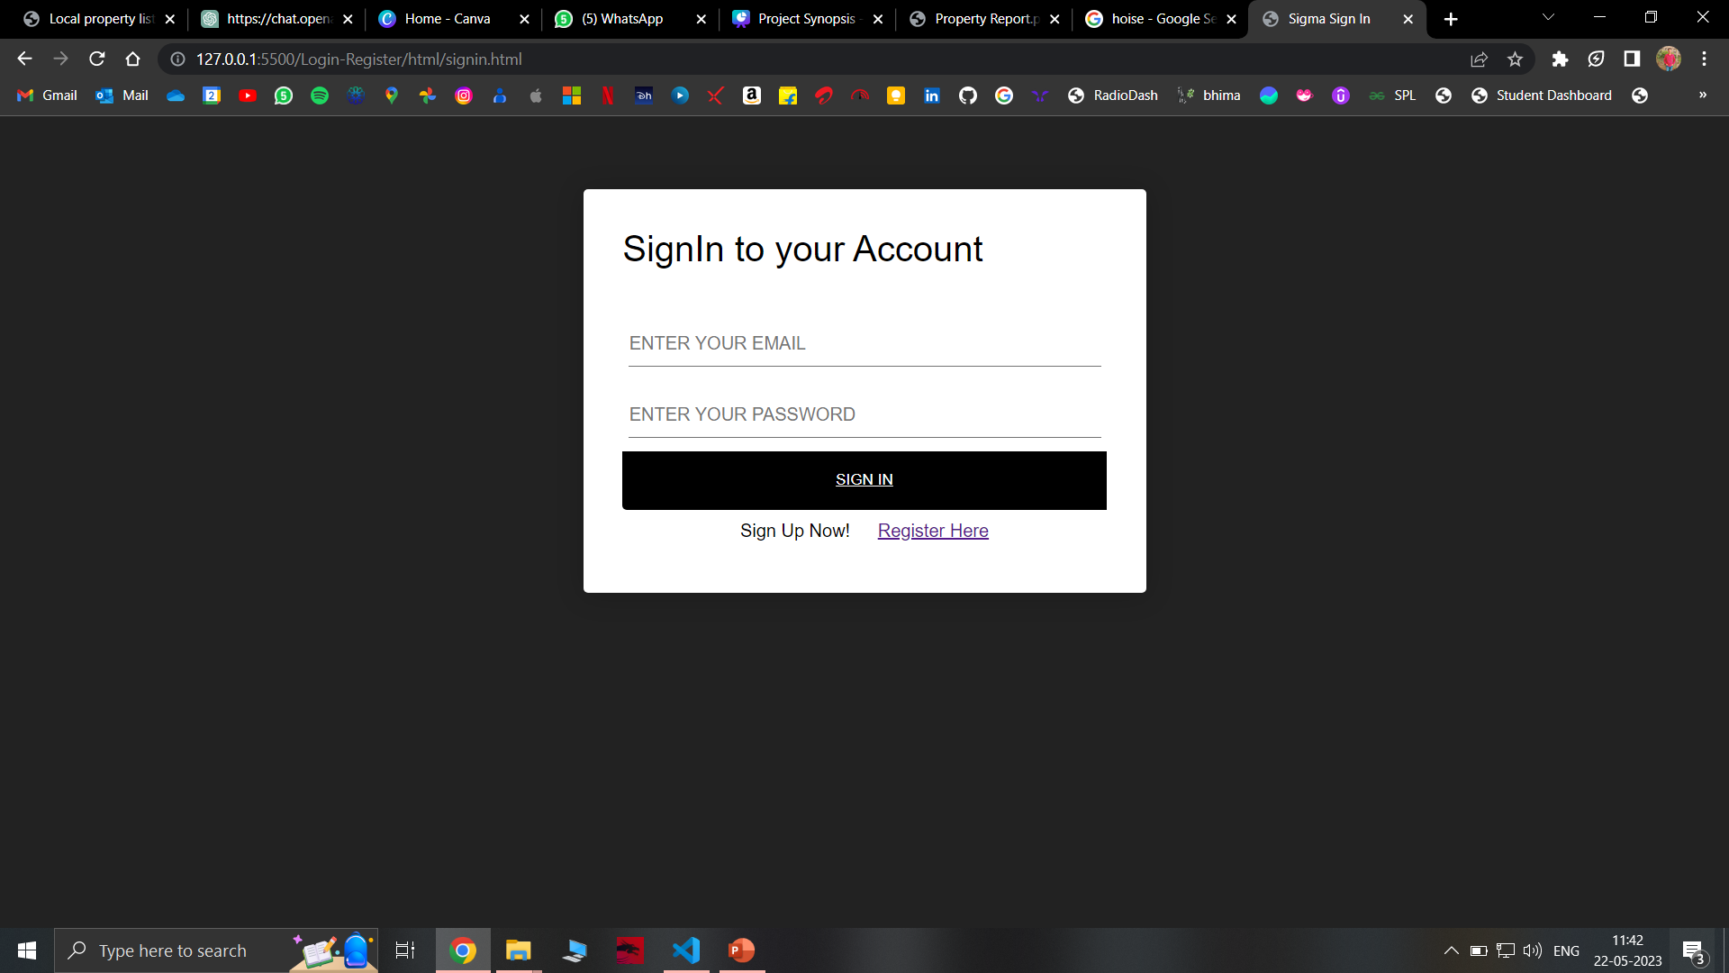
​Implementation details
This is the Sign In Page

Slide 10
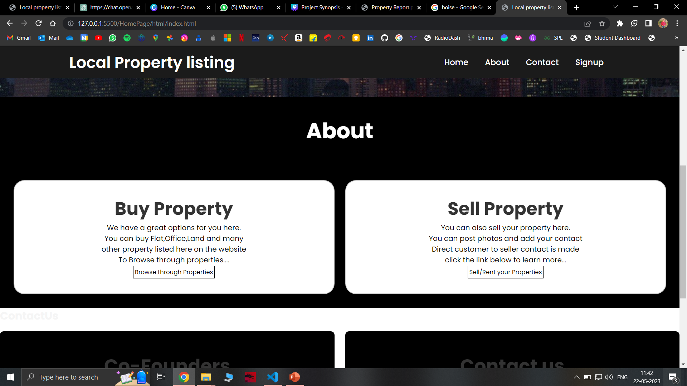
​Implementation details
This is the About Section

Slide 11
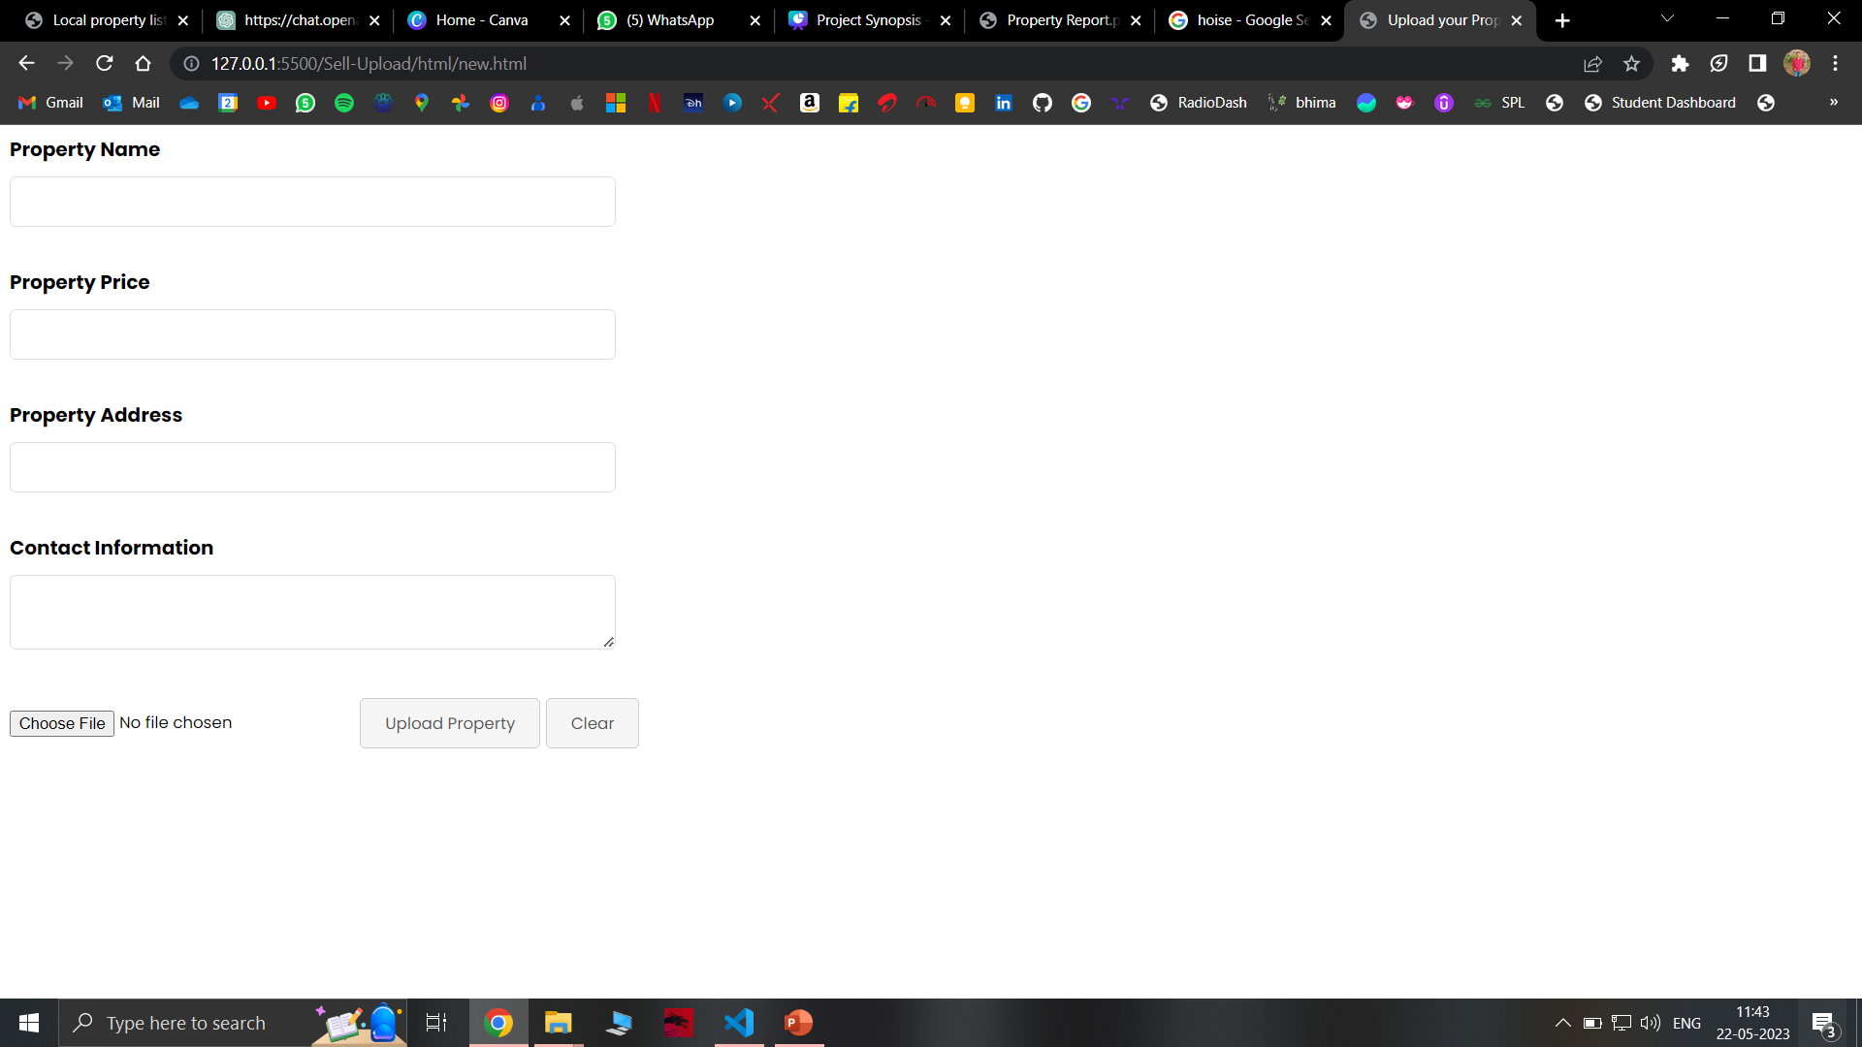
​Implementation details
This is the Page to Uplaod your Property

Slide 12
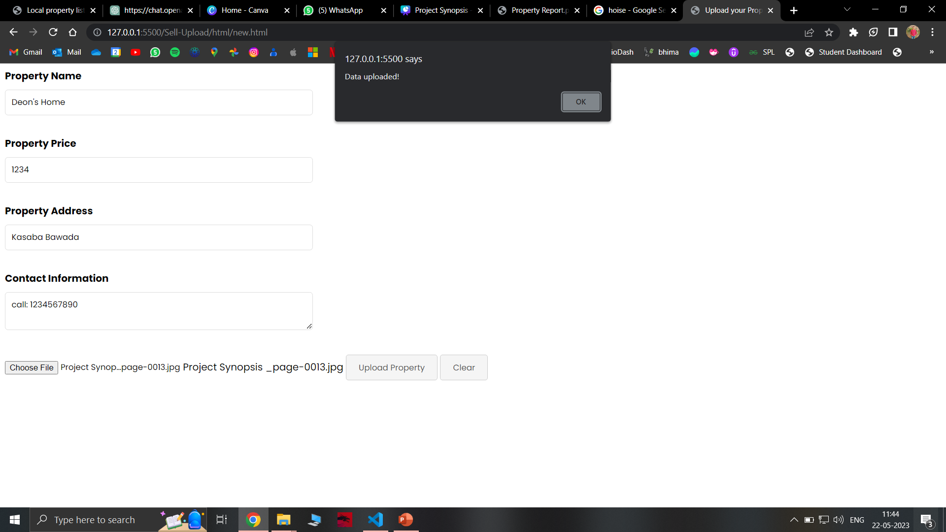
​Implementation details
This is the Upload

Slide 13
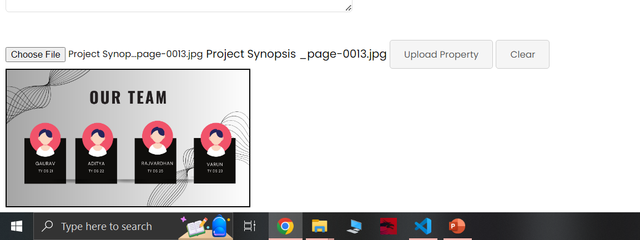
​Implementation details
Uploaded Image

Slide 14
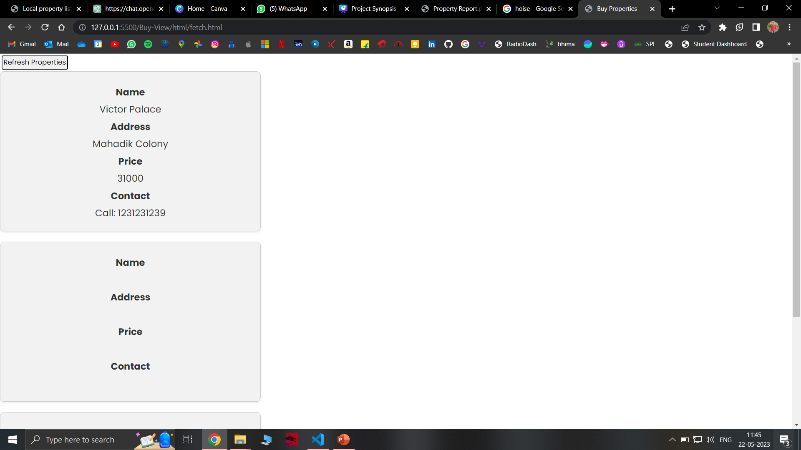
This is Buy Page

Slide 15
Future Scope
Enhanced Mobile App
Advanced Search Filters
Integration with External APIs
Real-time Notifications
Virtual Tours and Multimedia
Expansion to Additional Locations

Slide 16
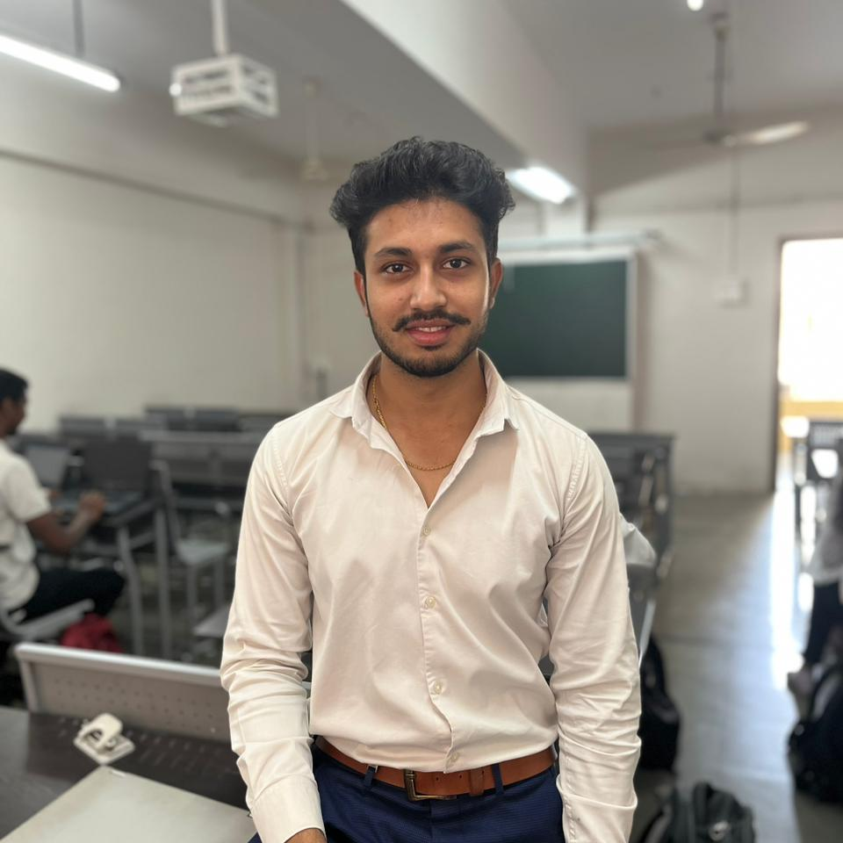
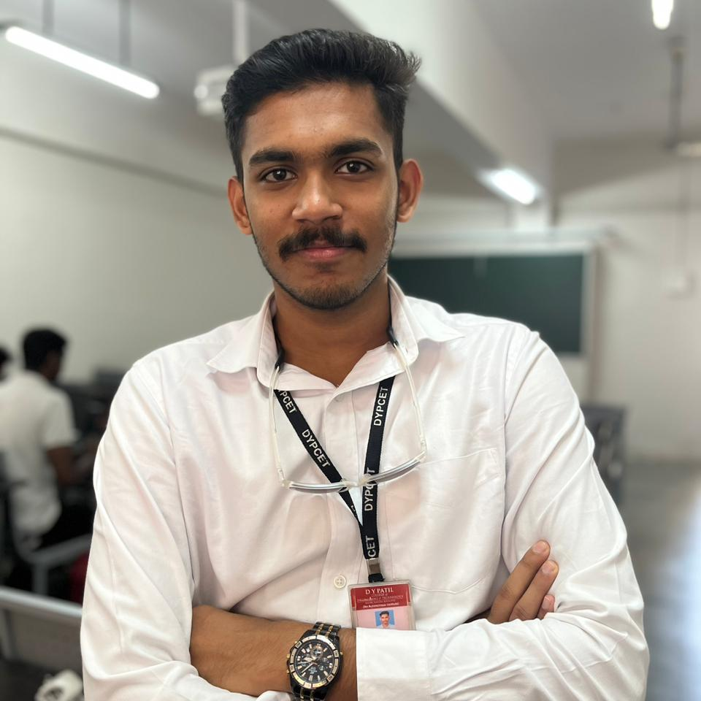
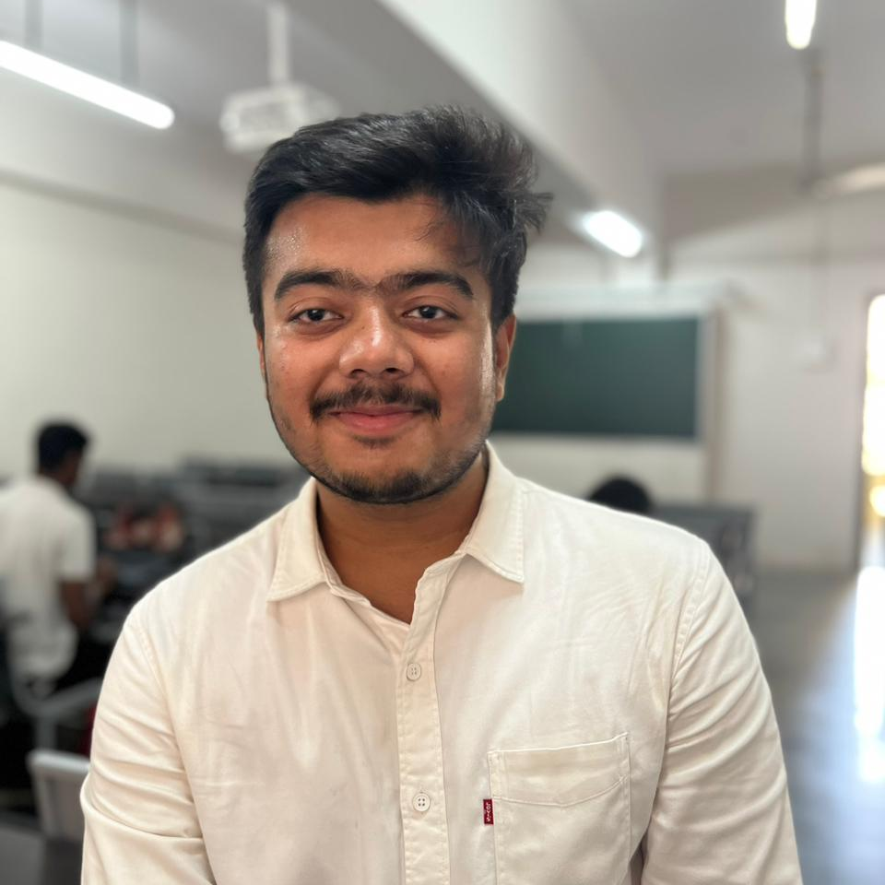
MEET OUR TEAM
Hrushikesh Shinde
Deon Chris Fernandes
Romit Shirke

Slide 17
THANK YOU

